Slide 1
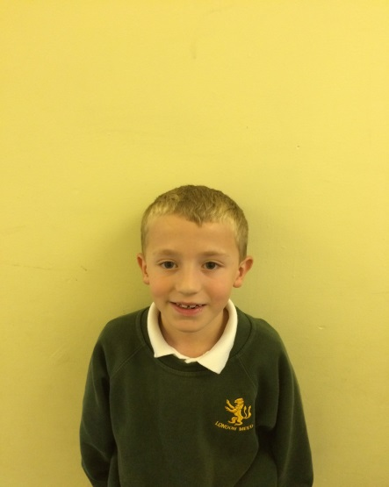
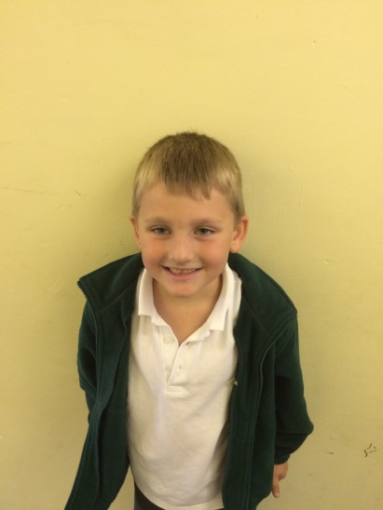
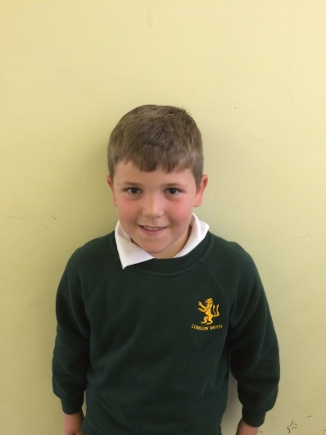
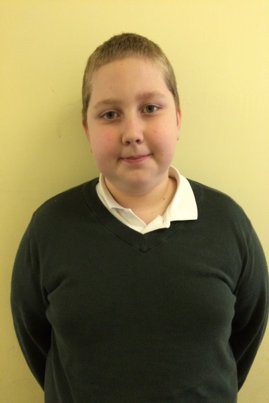
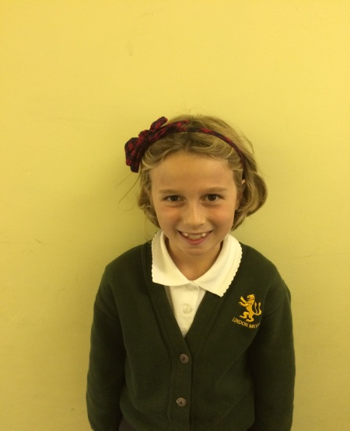
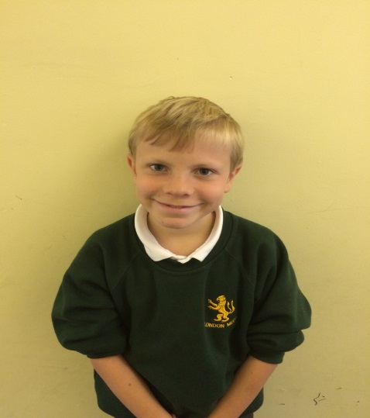
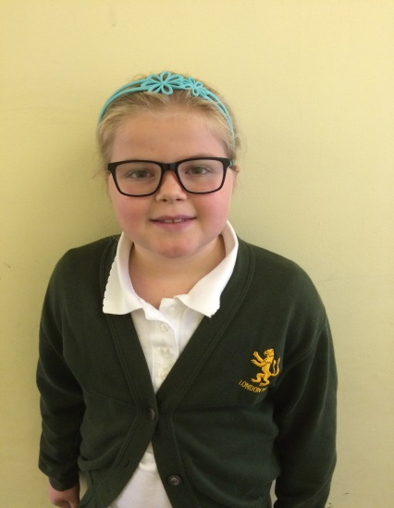
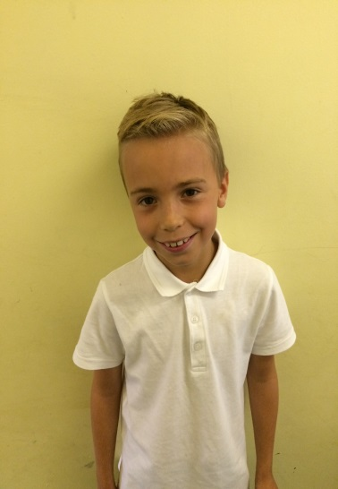
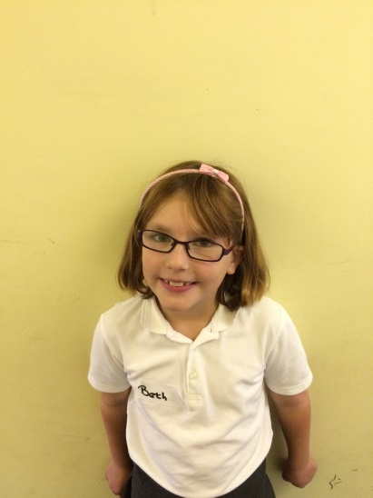
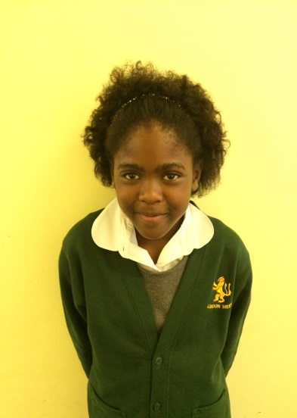
Learning Characters by the School Council

Slide 2
Introduction
What the School Council did:
We asked our classes what they thought made a good learner and came up with these learning behaviours: challenging, perseverance, questioning, independence, resilience and cooperation.

Slide 3
Then we asked you to think about which animals represented each learning behaviour. We bought some cuddly toys and gave them alliterative names.

Slide 4
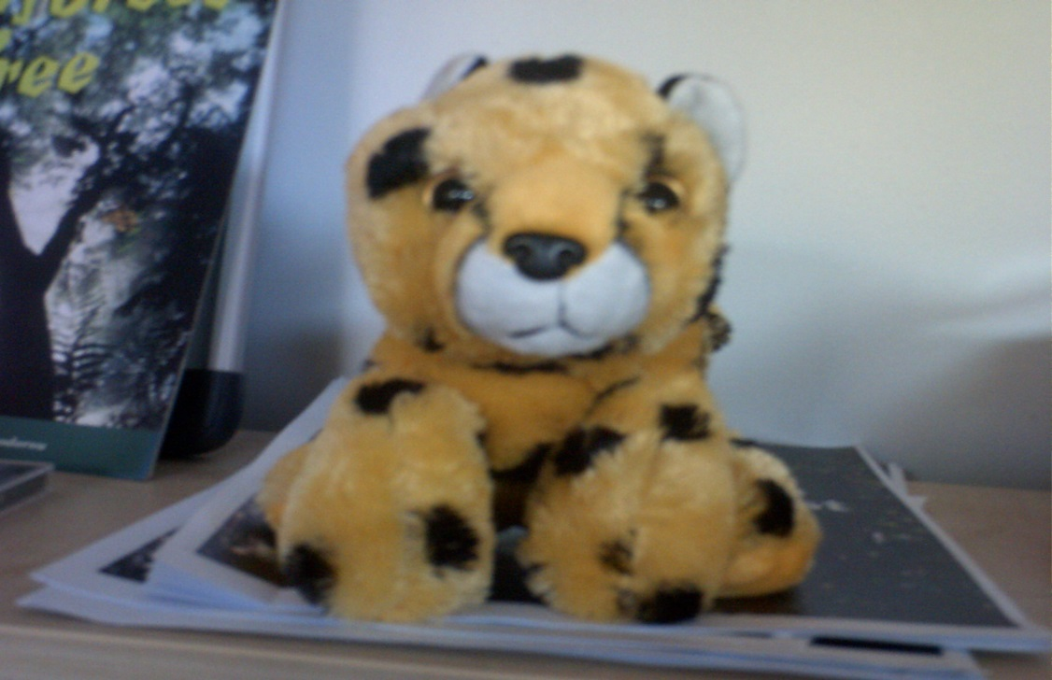
Challenge Charlotte
If you are like Challenge Charlotte you choose the right challenge for yourself. It should not be too easy or too difficult.
Don’t choose something just because your friend has chosen it.

Slide 5
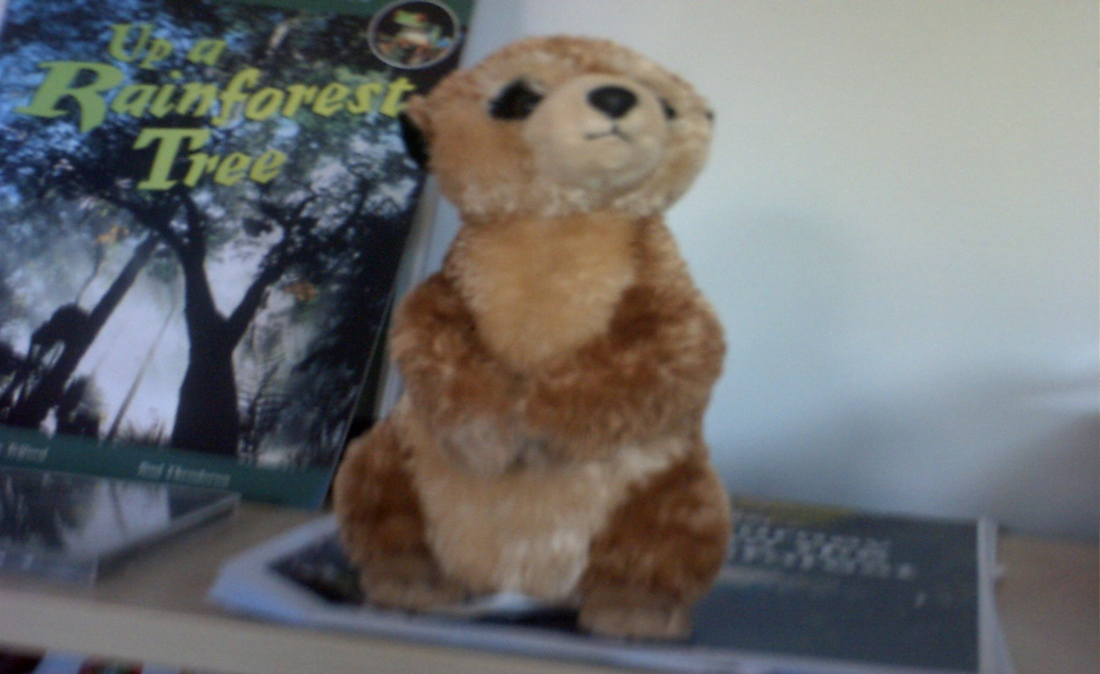
Cooperating Catherine
If you are a learner like Cooperation Catherine you will work well with other people.
You will listen to other people’s ideas and share your own.

Slide 6
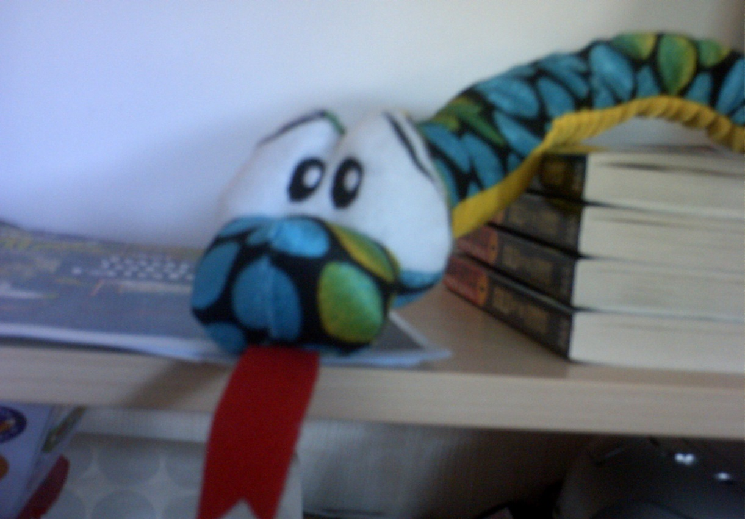
Independence Ivy
If you are like Independent Ivy you don’t need the support of others all the time.
You don’t wait to be told what to do and can try out your own ideas.

Slide 7
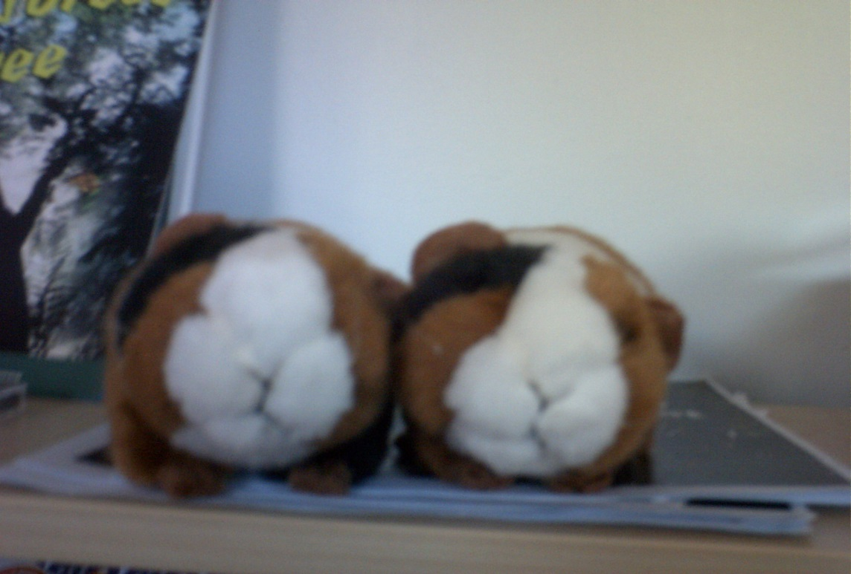
I can Isaac and I will William, the Perseverance Twins
If you are like the Perseverance Twins you will believe in yourself and say “I can” instead of “I cant” and “I will” instead of “I wont.”
You will not give up and will carry on if you make a mistake or find something difficult.

Slide 8
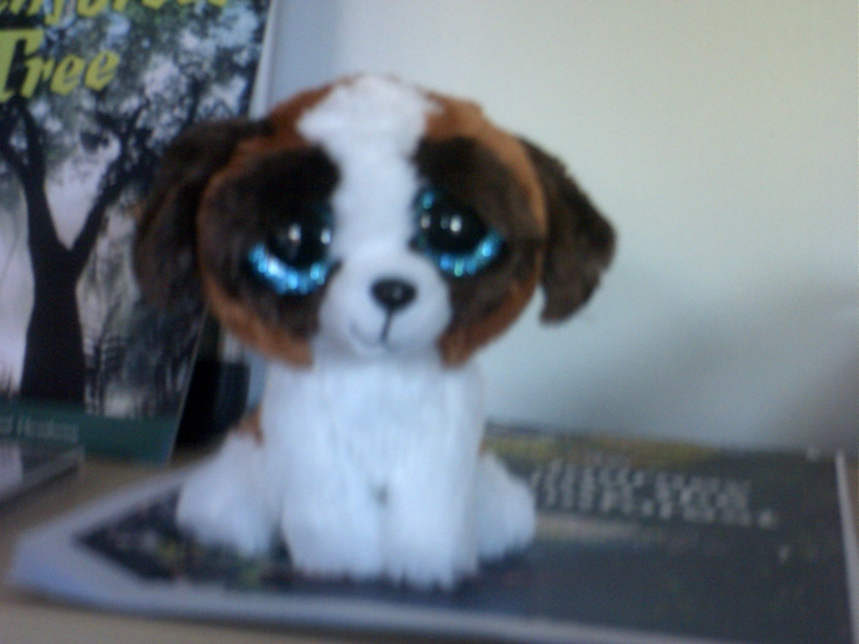
Resilience Russell
You are like Resilience Russell if you bounce back when you have hit a problem.
You will stay positive and try different ways of solving the problem.

Slide 9
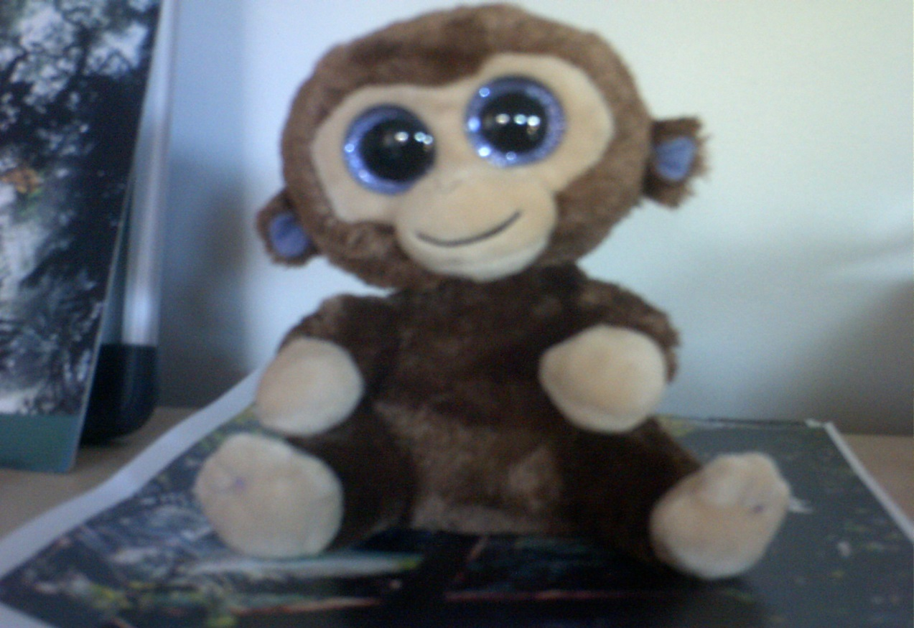
Questioning Quentin
Asking questions helps you to understand.
Every-time you ask a question you are learning something new.

Slide 10
How to use the characters
There are two sets of characters; one for KS1 and one for KS2
They will be kept in the library
They can be “borrowed” by classes
They can be given to a child who has shown that learning behaviour to look after for the day
What sort of things could get you a character?

