Slide 1
Mathematics Workshop for Key Stage2 Parents/Carers
Please note that this PPT can be found on the school website.
March 2018
Nicoleta Balan - Mathematics Subject Leader

Slide 2
1) The expectations of the National Curriculum 2) Programme of Study per year group 3) Concrete – Pictorial – Abstract representations 4) Calculation Policy 5) Bar Modelling 6) Number Laws 7) Practical maths 8) Ideas of how you can help your child 9) Please complete the evaluation sheet 10) Maths out of Class booklet – please take one!
Aims of the session:

Slide 3
National Curriculum Aims:

Slide 4
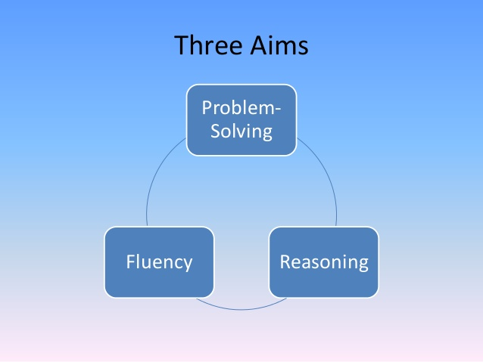
National Curriculum Aims:

Slide 5
In other words…
Fluency: the ability to recall and apply knowledge rapidly and accurately
Reasoning: explain their mathematical
thinking, justifying and proving it
Problem solving: apply their knowledge to solve problems in varied contexts; breaking down problems and persevering

Slide 6
Year 3 – Programme of Study:
Number, Place Value, Rounding
Addition and Subtraction (column method and regrouping using numbers up to 3 digits)
Multiplication (counting in multiples; repeated addition; arrays; grid method) and Division (within arrays; short division 2 digits by 1 digit)
Fractions and Decimals
Measure
Geometry
Statistics

Slide 7
Year 4 – Programme of Study:
Number, Place Value, Rounding
Addition and Subtraction (column method and regrouping using numbers up to 4 digits)
Multiplication (column multiplication using 2 and 3 digits multiplied by 1 digit) and Division (within arrays; with a remainder; short division up to 3 digits by 1 digit number)
Fractions and Decimals
Measure
Geometry
Statistics

Slide 8
Year 5 Programme of Study:
Number, Place Value, Rounding
Addition and Subtraction (column method; regrouping; with more than 4 digits; decimal numbers)
Multiplication (column method up to 4 digits by 1 or 2 digits) and Division (short division up to 4 digits by 1 digit number; interpret remainders appropriately for the context)
Fractions, Decimals and Percentages
Measure
Geometry
Statistics

Slide 9
Year 6 Programme of Study:
Number, Place Value, Rounding
Addition and Subtraction (column method; regrouping; decimals – with different amounts of decimal places)
Multiplication (column method; multi digit up to 4 digits by a 2 digit number; decimals) and Division (short division; long division up to 4 digits by a 2 digit number; interpret remainders as a whole, fractions or rounding up/down)
Fractions, Decimals and Percentages
Measure
Geometry
Statistics
Ratio and Proportion
Algebra

Slide 10
Concrete – Pictorial -Abstract
At London Meed Primary we believe
that all students (when introduced to a
key new concept) should have the
opportunity to build competency in this
topic by taking this approach.
This is why we work through a
Concrete – Pictorial – Abstract approach.

Slide 11
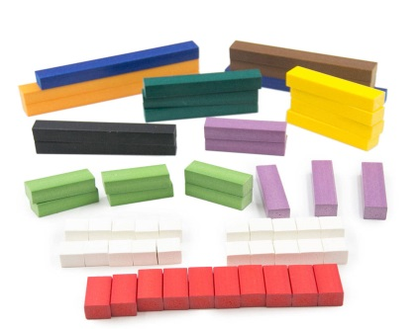
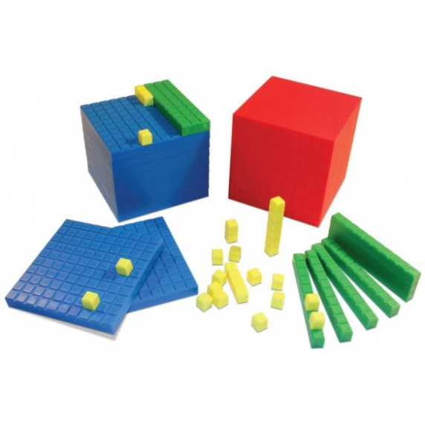
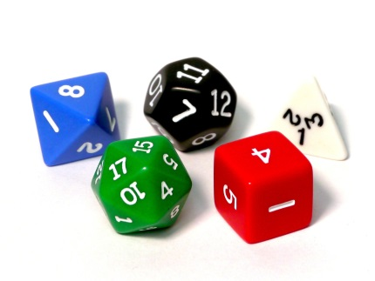
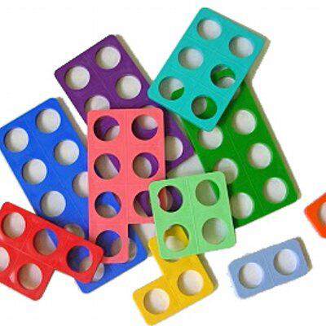
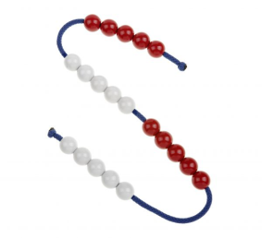
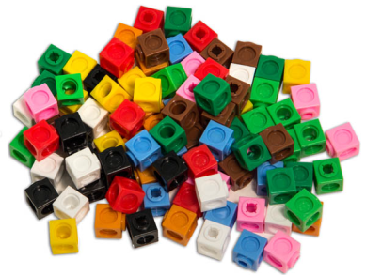
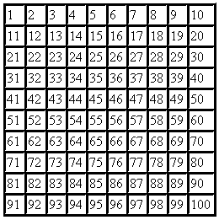
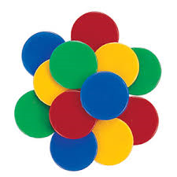
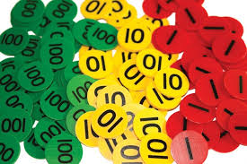
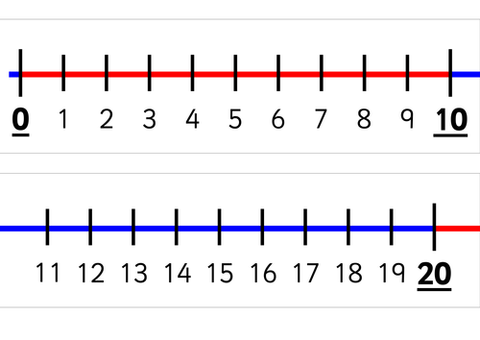
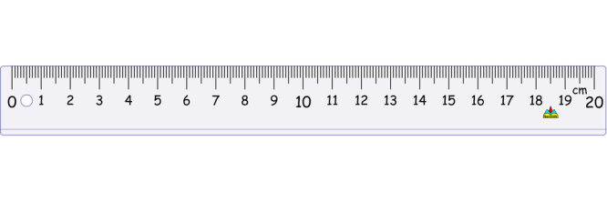
Concrete
Students have the opportunity to use concrete objects and manipulatives to help them understand what they are doing.
Dienes / Base 10 cubes
Dice
Cuisenaire rods
Numicon
Bead string
Multi link cubes
100 square/grid
Counters
Place value counters
Number line
Ruler

Slide 12
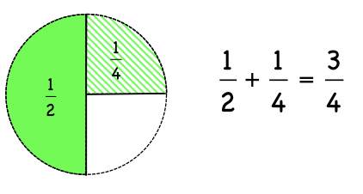
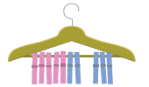
Pictorial
Students build on this concrete approach
by using pictorial representations. These
representations can then be used to reason
and solve problems.

Slide 13
Abstract / Symbolic
With the foundations firmly laid, students
should be able to move to an abstract
approach using numbers and key concepts
with confidence.

Slide 14
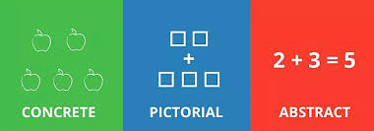
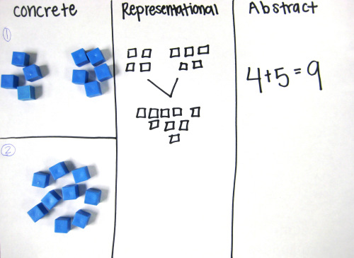

Slide 15
Calculation Policy: addition

Slide 16
Calculation Policy: addition

Slide 17
Calculation Policy: addition

Slide 18
Calculation Policy: subtraction

Slide 19
Calculation Policy: subtraction

Slide 20
Calculation Policy: subtraction

Slide 21
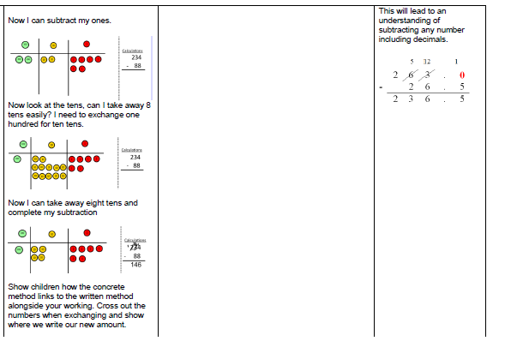
Calculation Policy: subtraction

Slide 22
Calculation Policy: multiplication

Slide 23
Calculation Policy: multiplication

Slide 24
Calculation Policy: multiplication

Slide 25
Calculation Policy: multiplication

Slide 26
Calculation Policy: division

Slide 27
Calculation Policy: division

Slide 28
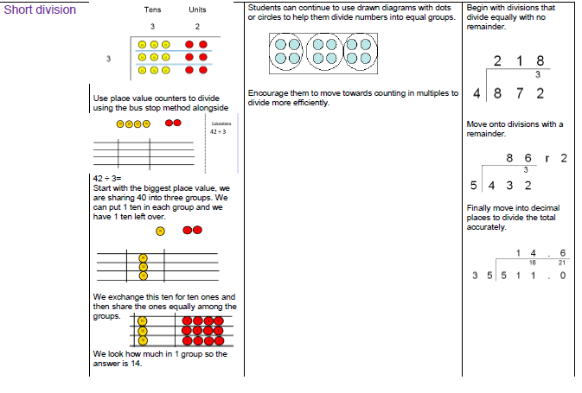
Calculation Policy: division

Slide 29
Calculation Policy: division

Slide 30
By the end of Year 6

Slide 31
Times Table Test
Which children will sit the multiplication test?
The Times Table Test will be introduced in English schools only. It will be taken by children in Year 4, in the summer term (in June). In June 2019 the multiplication check will be voluntary (schools will be able to decide whether to administer it or not). In June 2020 it will become compulsory for all English schools.
How children will be tested?
Children will be tested using an on-screen check, where they will have to answer multiplication questions against the clock. The test will last no longer than 5 minutes and is similar to other tests already used by primary schools. Their answers will be marked instantly.

Slide 32
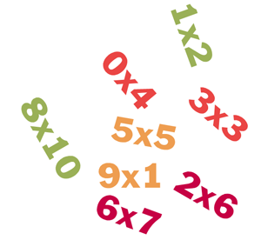
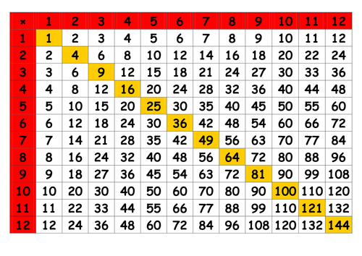
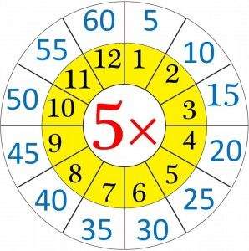
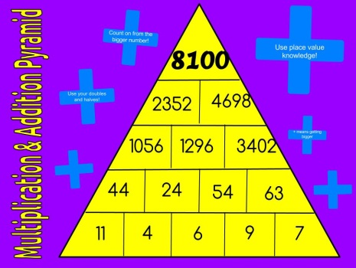
Fast Learning

Slide 33
Bar model – pictorial representation of a problem

Slide 34
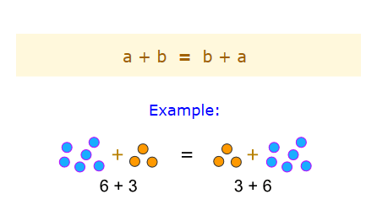
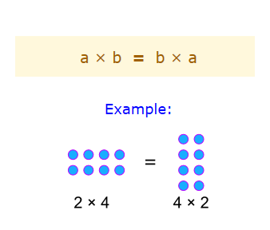
Number Laws
1. Commutative Law: we can swap numbers over and still get the same answer.
Addition
Multiplication

Slide 35
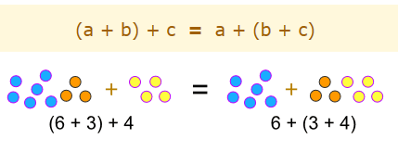
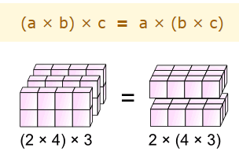
Number Laws
2. Associative Law: it doesn’t matter how we group the numbers, we still get the same answer.
Addition
Multiplication

Slide 36
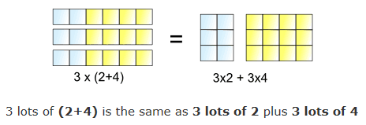
Number Laws
3. Distributive Law: we get the same answer when we multiply a number by a group of numbers added together OR when we multiply each number separately, then add the products together.

Slide 37
Fluency
Years 3 & 4 examples:
Continue the pattern: 50, 100, 150, 200, _, _,_(Number and Place Value – Year 3)
3 x ? = 24 (Multiplication and Division - Year 3)
7m + ? = 810cm (Measurement – Year 3)
Round 3.2 to the nearest whole number (Decimals – Year 4)
Find 2/5 of 45 (Fractions – Year 4)
2 hours = ? Minutes (Time - Year 4)

Slide 38
Fluency
Years 5 & 6 examples:
Write 283 in Roman Numerals (Number and Place Value –Year 5)
740 + ? = 1039 (Addition and Subtraction –Year 5)
Find 5 equivalent fractions of ¾ (Fractions – Year 5)
200 x ? = 750 + ? (Multiplication and Division – Year 6)
4/7 ÷ 5 (Fractions – Year 6)
75% of £1340 (Percentages – Year 6)

Slide 39
Reasoning
Years 3 & 4 examples:
Tom says ‘I can use my 4 times table to help me work out my 8 times table’. Is he correct? Convince me. (Multiplication and Division – Year 3)
Which would you rather have, three quarters of £2.40 or one quarter of £6? Explain your reasoning. (Money/Fractions – Year 4)

Slide 40
Reasoning
Years 5 & 6 examples:
Sophie thinks 1.007 is bigger than 1.01 because 7 is bigger than 1. Do you agree? Explain why. (Decimals – Year 5)
Jenny travels 652 miles to go on holiday. Abbie thinks she travels further because she travels 1412 kilometres. Is Abbie right? Explain why.(Measure – Year 6)

Slide 41
Language of Reasoning
If … then …
This is always true because…
This is the same because…
It must be because…
It can’t be because…
This is different because…
I already know that… so…
This is true here because…

Slide 42
Problem Solving
Years 3 & 4 examples:
A group of aliens live on Planet Xert. Tinions have three legs, Quinions have four legs. The group has 22 legs altogether. How many Tinions and Quinions might there be? Is there more than one solution? (Multiplication and Division – Year 3)
Does the number 4 appear more or less on a 12-hour digital clock than a 24- hour digital clock? (Time –Year 4)

Slide 43
Problem Solving
Years 5 & 6 examples:
Temperature falls by about 1⁰C for every 100 metres height gain. Abigail is standing on top of a mountain at 900 metres above sea level. The temperature is – 3⁰C. Abigail walks down the mountain to sea level. What should she expect the temperature to be? (Place Value – Year 5)
Find the smallest number that can be added to 92.7 to make it exactly divisible by 7. (Decimals – Year 6)

Slide 44
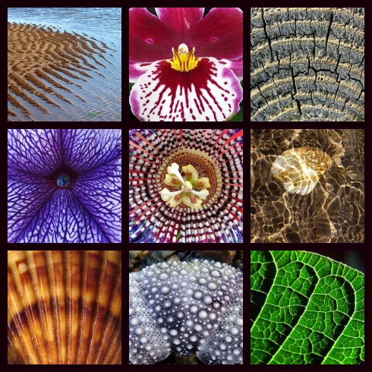
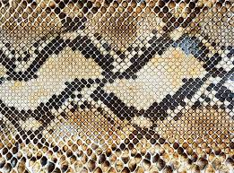
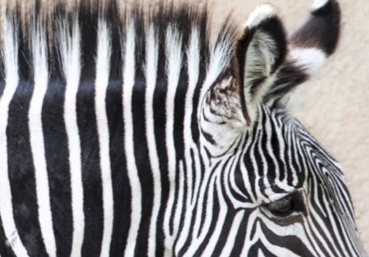
Maths at home and out and about
In the house e.g. laying the table
Counting
Shopping
Stories – ask mathematical questions
Pictures/ paintings
Money
Time
Patterns in nature
Home Learning
Booklet Mathematics Activities Out of Class

Slide 45
How many perpendicular lines can you spot?
How many different shapes are there?
Where can you see symmetry in the picture?
How many parallel lines can you see?
How many right angels can you spot?
How many 3D shapes can you find?

Slide 46
A few quick suggestions
Please encourage your child to:
form numerals and mathematical symbols correctly (2, 6, 9, £, %, =, ⁰C)
use a ruler
practise their times tables and the related division facts on a regular basis
identify their errors and discuss how to correct them

Slide 47
Helpful websites for mathematical concepts and vocabulary:
Math is Fun
https://www.mathsisfun.com/
11 Plus for Parents
http://www.11plusforparents.co.uk/
For Mathematical Vocabulary also refer to the MATHS Vocabulary.PDF document which can be found on the school website under Mathematics.

Slide 48
Any Questions?
Thank you for coming!

