Slide 1
Mathematics Workshops

Slide 2


Rationale
“Do you know anyone who feels neutral about maths? We suspect not. Indeed, we would go as far as to suggest that the majority of people either love it or hate it.” (Cockburn and Littler 2008, p.3)

Slide 3
Aims of the new National Curriculum
Aims
The national curriculum for mathematics aims to ensure that all pupils:
become fluent in the fundamentals of mathematics, including through varied and frequent practice with increasingly complex problems over time, so that pupils develop conceptual understanding and the ability to recall and apply knowledge rapidly and accurately
reason mathematically by following a line of enquiry, conjecturing relationships and generalisations, and developing an argument, justification or proof using mathematical language
can solve problems by applying their mathematics to a variety of routine and non-routine problems with increasing sophistication, including breaking down problems into a series of simpler steps and persevering in seeking solutions

Slide 4


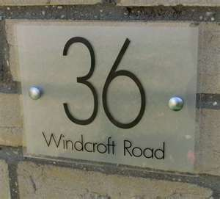


Aims:
Aims:
We want children to leave KS1 with a bank of mathematical skills, the confidence to use and apply them in everyday situations, the ability to take risks and enjoy challenges.
Maths is everywhere!

Slide 5
Mathematics in EYFS
Songs
Stories
Role play
Counting
Structured play opportunities

Slide 6
Mathematics in KS1
Real life contexts
(Learning Journeys at LM)
Resources
Models and Images
Calculation methods

Slide 7
Resources in KS1
Numicon
Dice
Number squares
Number lines
Counters
Unifix

Slide 8
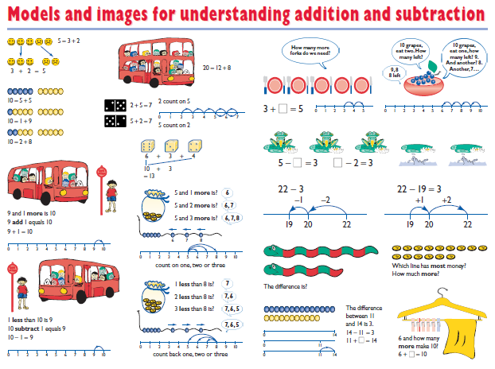
Models and Images in KS1

Slide 9
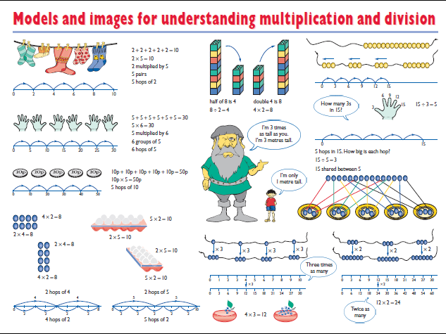
Calculation Methods in KS1
Number line for addition and subtraction
Number line for multiplication and division
n

Slide 10
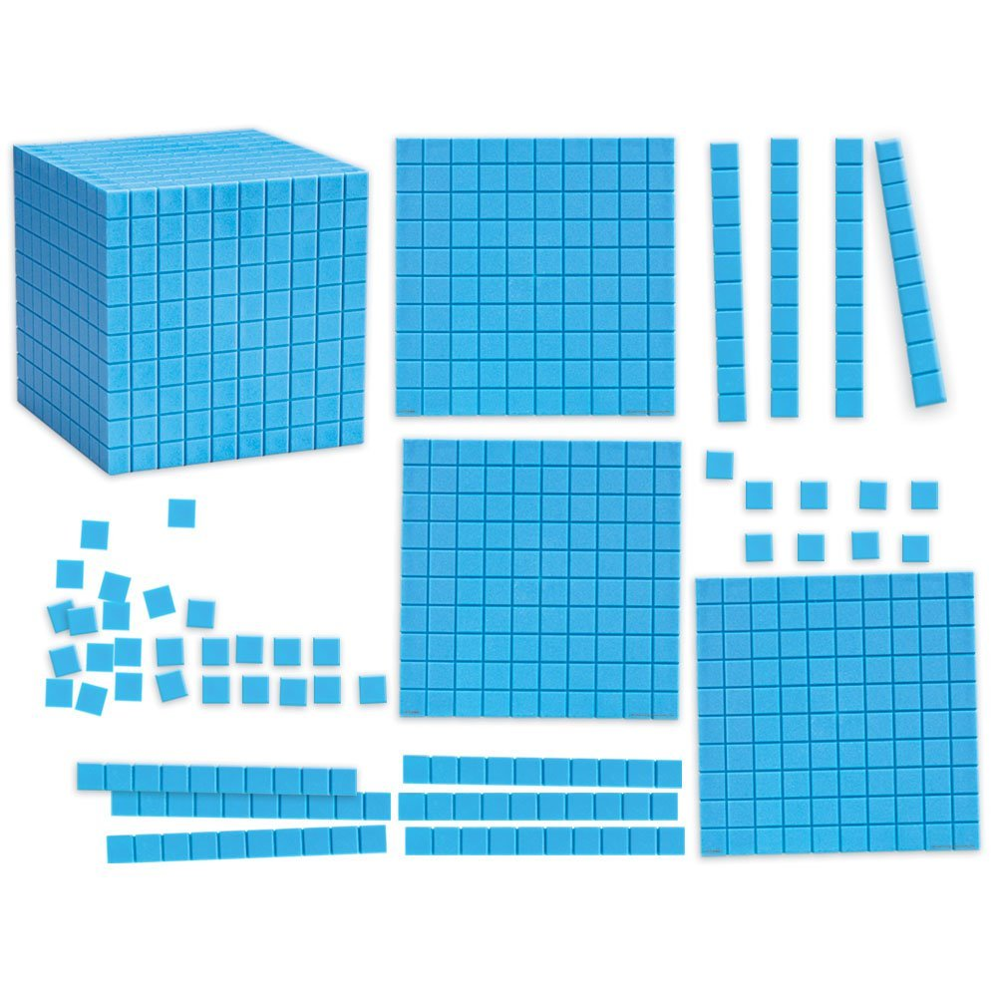
Resources in KS2

Slide 11
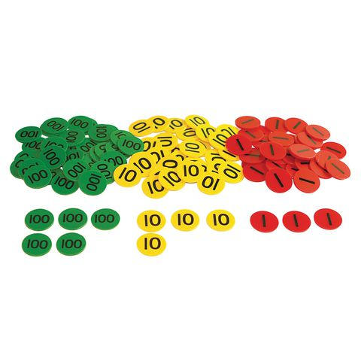
Resources

Slide 12
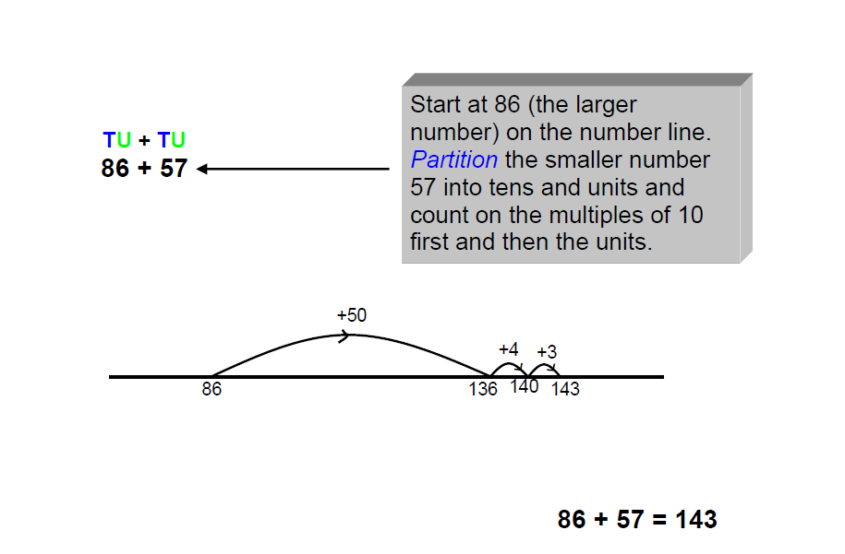
Calculation Methods in KS2
Addition

Slide 13
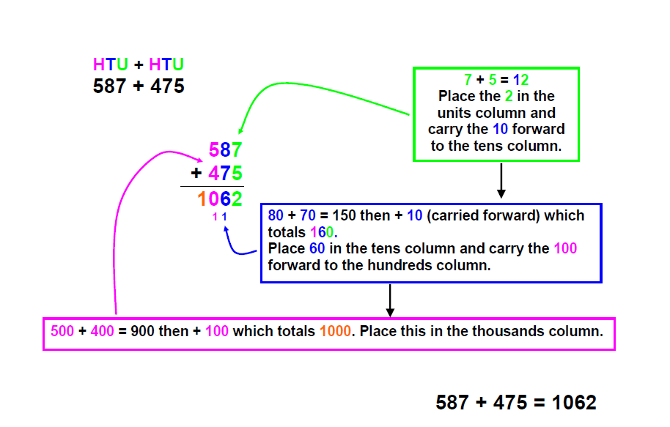

Slide 14
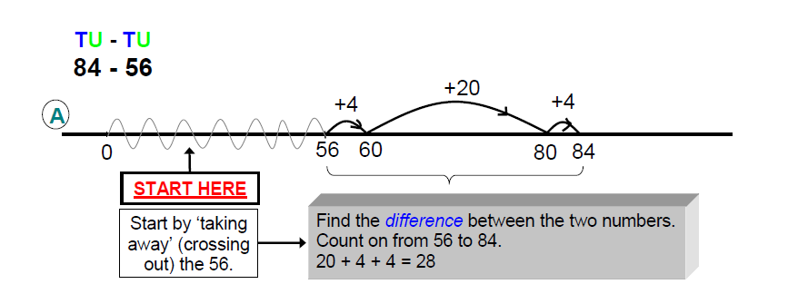
Subtraction

Slide 15
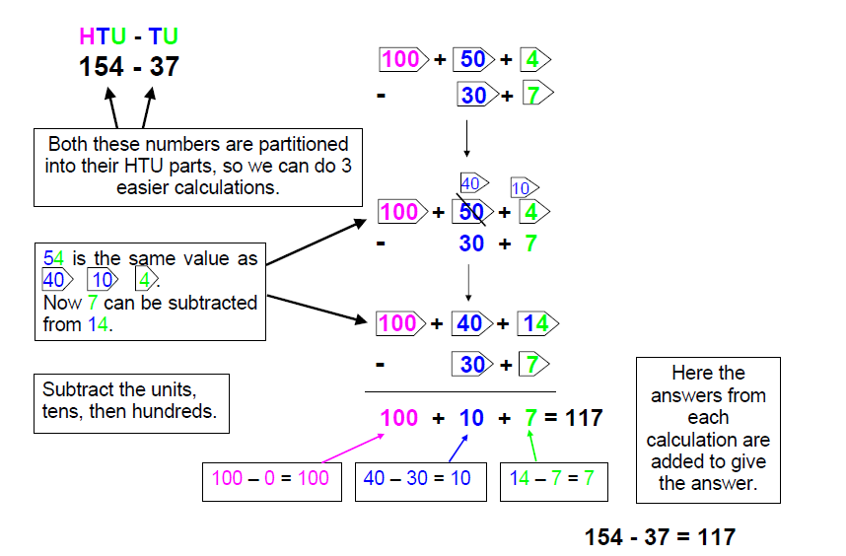

Slide 16
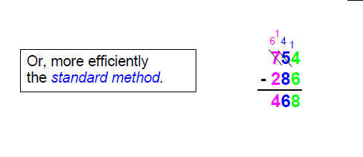

Slide 17
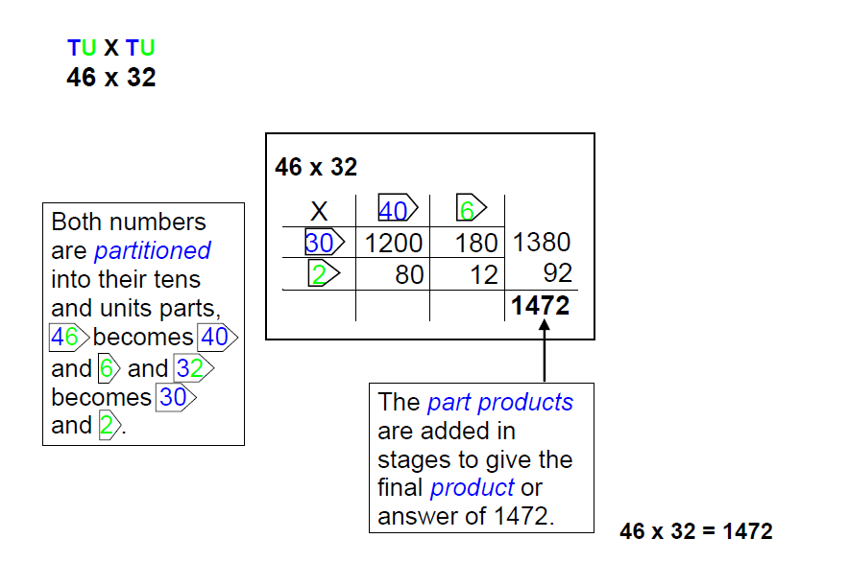
Multiplication

Slide 18
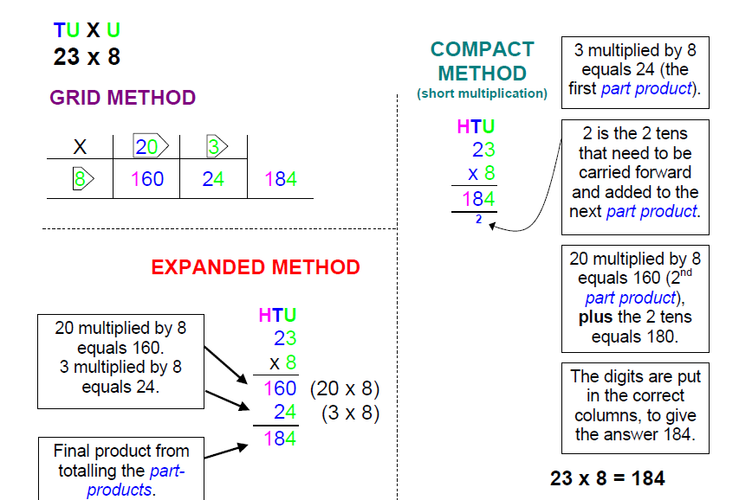

Slide 19
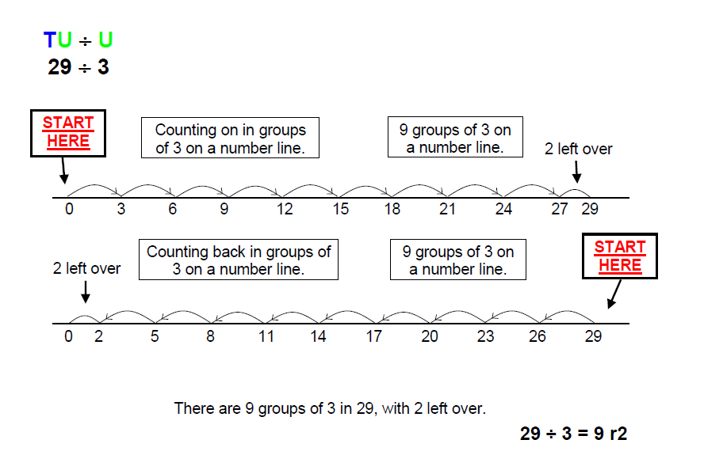

Slide 20
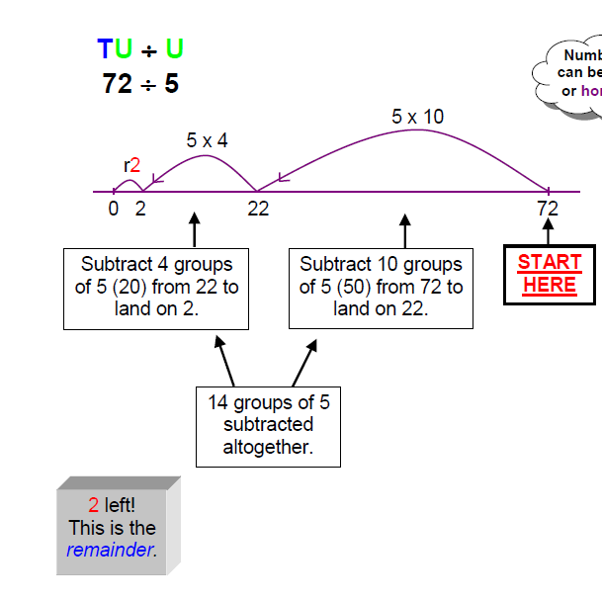

Division

Slide 21
