Slide 1
Assessment for Learning
September 4th 2015
Natalie Langtree

Slide 2
What is Assessment for Learning?

Slide 3
A classroom where AfL is strong will have:

Slide 4
Talk Partners

Slide 5
Mixed Ability Learning

Slide 6
Classroom Layout Experiment! You don’t have to have groups of 6 or 8.

Slide 7
Making mixed ability teaching and learning work

Slide 8
Questioning
What is the purpose of questioning?
What makes a good question?

Slide 9
Socratic Questioning – tell me more!
Why are you saying that?
What exactly does this mean?
What do you mean by …?
How does this relate to what we have been talking about?
What is the nature of ...?
What do we already know about this?
Can you give me an example?
Are you saying ... or ... ?
Can you rephrase that, please?

Slide 10
Learning Intentions, Success Criteria and Developing Excellence

Slide 11
Examples of tasks to uncover prior knowledge:
Odd One Out
Starting with the wrong answer
Sorting success criteria
Sorting objects
Role play
Surprise letter
Agree or disagree statement
True or false statements

Slide 12
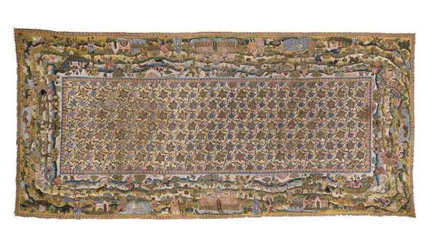
Quality Comparison to Generate SC Activity – Find the perimeter
4m + 4m = 8m
2m + 2m = 4m
8m + 4m = 12m
P = 12m
4m x 2m = 8m
P=8m

Slide 13
Effective peer and self assessment
Key requirements in developing these skills:

Slide 14
Growth Mindset

Slide 15
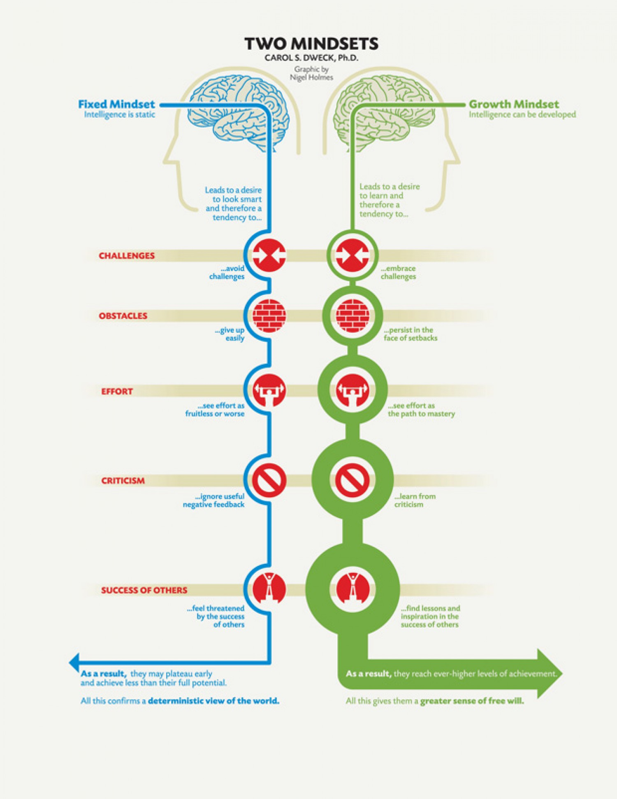

Slide 16
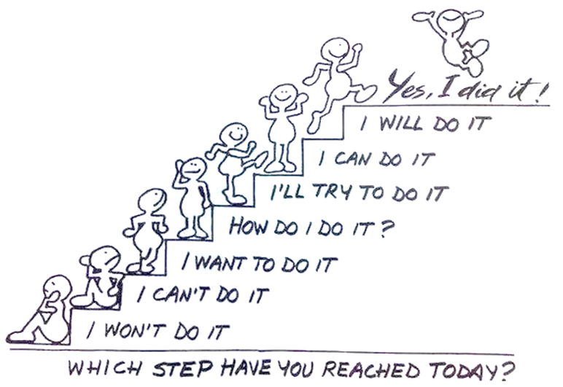
Or put another way…

Slide 17
Happy, healthy neurons chat to each other.

Slide 18
Time, effort, practice and input. This is really making me think! I can feel my neurons connecting.

Slide 19
Fixed or Growth
Activity

Slide 20
Fixed Mindset
Intelligence is static. I must look clever !
Avoids challenges
Gives up easily
Sees effort as pointless
Ignores useful criticism
Likely to plateau early and achieve less than full potential
Growth Mindset
Intelligence is expandable. I want to learn more!
Embraces challenges
Persists in the face of setbacks
Sees effort as the way
Learns from criticism
Reaches ever –higher levels of achievement

Slide 21
Activity
Remember pupils from your last class. Did they have a fixed or a growth mindset?
What about your own mindset?

Slide 22
Creating a growth mindset culture in the classroom

Slide 23
Panic
Stretch
Comfort

Slide 24
Activity 3
Runa and Jon each start with the same number.
Runa rounds the number to the nearest hundred. Jon rounds the number to the nearest ten.
Runa’s answer is double Jon’s answer. Explain how this can be.

Slide 25
Answer • 53 to the nearest hundred is 100, and to the nearest ten is 50 and 2 × 50 = 100 • If it’s 50 or more but less than 55 it will round to 100 (nearest hundred) and 50 (nearest ten) and 100 is double 50 • 0 is 0 to the nearest 100 and 0 to the nearest 10 and twice 0 is 0

Slide 26
Yet
I can’t do this …
Avoids panic and encourages stretch

Slide 27
Praise language –focuses on achievement and effort
Well done. You’re learning to …
Good, it’s making you think – that’s how you know your brain is growing.
Every time you practise, you’re making the connections in your brain stronger.
You’re good at the things you like because you spend longer doing them.
Your skills have really improved. Do you remember how much harder this was last week.
You mean you don’t know YET!

Slide 28
A Fixed or Growth Mindset - questionnaires and scenarios to try with children

Slide 29
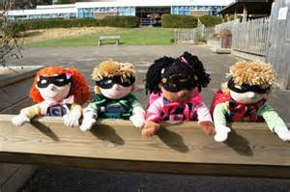
Learning to learn
Learning not work
Learning muscles and learning powers
Characters to represent the learning powers

Slide 30
Successful learning means:
Concentrate
Don’t give up
Be cooperative
Be curious
Have a go
Use your imagination
Keep improving
Enjoy learning
Which learning powers have you used today?

Slide 31
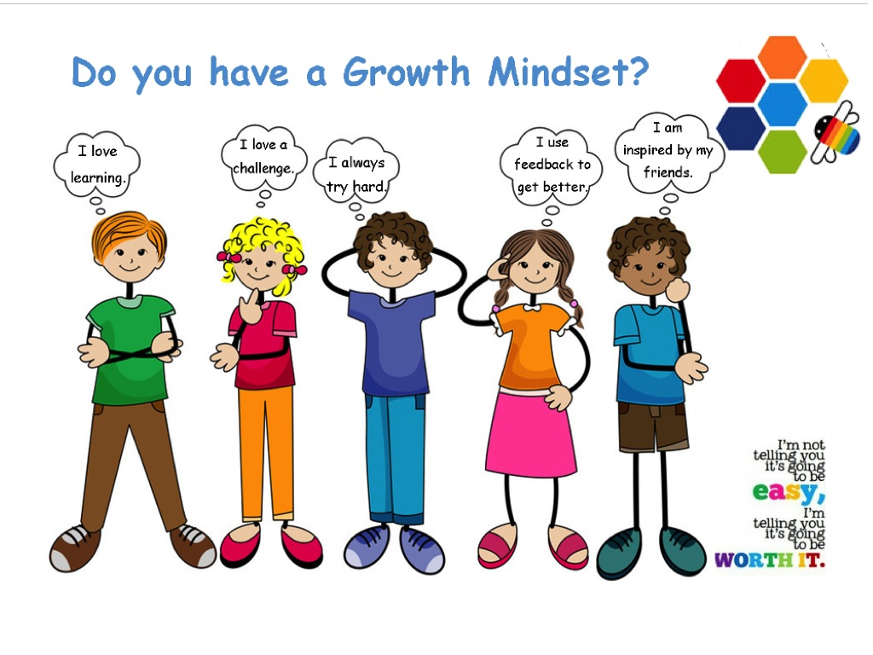
Activity
With your Talk Partner, create a Growth Mindset poster for your classroom.

